Slide 1
FITE7410
Introduction to Financial Fraud Analytics
Lecturers: Dr. Vivien Chan, Annie Chan
Tutor: Yanan Gong
Department of Computer Science
The University of Hong Kong
http://www.free-powerpoint-templates-design.com

Slide 2
Today’s Agenda
Introduction to Financial Fraud Analytics
01
02
Credit Card Fraud Scheme
Intro to Exploratory Data Analysis (EDA)
03
Tutorial of R
1-hour tutorial of R

Slide 3
01 Introduction to Financial Fraud Data Analytics
Dr. Vivien CHAN

Slide 4

Question:
What is
“Financial Fraud”?
Any examples?
What is
“Financial Fraud”?
Any examples?

Slide 5
Definition of “Fraud”
English Dictionary definition
“the crime of getting money by deceiving people”
Legal Dictionary definition
“the intentional use of deceit, a trick or some dishonest means to deprive another of his/her/its money, property or a legal right. ”
(Ref: “Cambridge Dictionary: fraud”. https://dictionary.cambridge.org/)
(Ref: "Legal Dictionary: fraud". Law.com)

Slide 6
Related ordinances of financial crimes in HK
The main offences are included in the Crimes Ordinance (Cap. 200) (CO) and the Theft Ordinance (Cap. 210) (TO).
Additional offences can be found in various ordinances, including the:
Securities and Futures Ordinance (Cap. 571) (SFO).
Companies Ordinance (Cap. 622) (COMPO).
Telecommunications Ordinance (Cap. 106) (TELEO).
Inland Revenue Ordinance (Cap. 112) (IRO).
This is not a legal course, details would not be discussed.

Slide 7
HK legal definition
CAP 210 THEFT ORDINANCE Section 16A Fraud
(Ref: HKLII, https://www.hklii.hk/cgi-bin/sinodisp/eng/hk/legis/ord/210/s16A.html)
(1)If any person by any deceit (whether or not the deceit is the sole or main inducement) and with intent to defraud induces another person to commit an act or make an omission, which results either
(a)in benefit to any person other than the second-mentioned person; or
(b)in prejudice or a substantial risk of prejudice to any person other than the first-mentioned person,
the first-mentioned person commits the offence of fraud and is liable on conviction upon indictment to imprisonment for 14 years.
(2)For the purposes of subsection (1), a person shall be treated as having an intent to defraud if, at the time when he practises the deceit, he intends that he will by the deceit (whether or not the deceit is the sole or main inducement) induce another person to commit an act or make an omission, which will result in either or both of the consequences referred to in paragraphs (a) and (b) of that subsection.

Slide 8
HK legal definition
Under HK’s law, The Theft Ordinance contains a range of specific offences relating to fraud, including:
section 17: Obtaining property by deception
section 18: Obtaining pecuniary advantage by deception
section 18A: Obtaining services by deception
section 18B: Evading liability by deception
section 18C: Making off without payment
section 18D: Procuring false entries in records of banks and deposit-taking companies
section 19: False accounting
section 22: Suppression of documents.

Slide 9
Types of Financial Frauds
There is no single definition of financial fraud type.
One of the categorization by FBI is as follows ( selected from the list provided in the Federal Bureau of Investigation, Financial Crimes Report (2010–2011), United States ):
Bank Fraud
Credit Card Fraud
Mortgage Fraud
Money Laundering
Corporate Fraud
Financial Statement Fraud
Securities and Commodities Fraud
Insurance Fraud
Automobile Insurance Fraud
Health Care Fraud
Fraud Analytics of these financial frauds to be discussed in upcoming lectures

Slide 10
Fraud Triangle
The Fraud Triangle Theory is developed by criminologist, Donald Cressey
Pressure
Rationalization
Opportunity
First leg and concerns the main motivation for committing fraud
A pressure or a problem is experienced of financial, social, or any other nature
It cannot be resolved or relieved in an authorized manner
Second leg and concerns the precondition for committing fraud
Opportunity exists to resolve or relieve the experienced pressure in an unauthorized but concealed or hidden manner
Psychological mechanism that explains why fraudsters do not refrain from committing fraud and think of their conduct as acceptable

Slide 11
What is
“Financial Fraud Data Analytics”?

Slide 12
What is Financial Fraud Data Analytics?
In this course, Financial Fraud Analytics is:
The process of using machine learning/data mining techniques to analyse financial fraud data for red flags that correlate to financial frauds
The end product of fraud analytics is a sample of transactions that have a higher probability of containing one fraudulent transaction versus a random sample of transactions used to test control effectiveness
To answer the question:
Is there credible evidence that a fraud scenario is occurring? Should we perform an investigation?
In this course, Financial Fraud Analytics is NOT:
about forensic fraud investigation

Slide 13
Good Practice of Financial Fraud Analytics
Plan before you act – a good fraud analytics plan is required before jumping into data analysis
Well-defined scope for fraud analytics
Good understanding of fraud data, e.g.
correct identification of red flags vs error in data
ability to identify false positives and false negatives, and how to handle these observations
Jumping to conclusions without correct and logical linkage to evidence found

Slide 14
What is a Red Flag?
A red flag is an observable condition that relates to the act of a specific fraud scenario
Fraudsters may be detected by deviant behaviours from non-fraudsters. These deviations from normality are red flags of fraud, i.e. anomality or variation from predictable patterns of normal behaviours
A red flag exists in:
Data
Documents
Internal controls
Behaviours
Public records
Digital footprints
… etc.

Slide 15
What are examples of ‘anomalities’?

Slide 16
What is a Red Flag?
Examples of anomality:
Outliers
Inliers where they are not expected
Too many or too few transactions
Unexplained items
Unusual relationships between items
Unexpected timing of transactions or events
Inconsistencies
Gaps or duplicates of item numbers
Unexpected payment methods
Unreasonable items

Slide 17
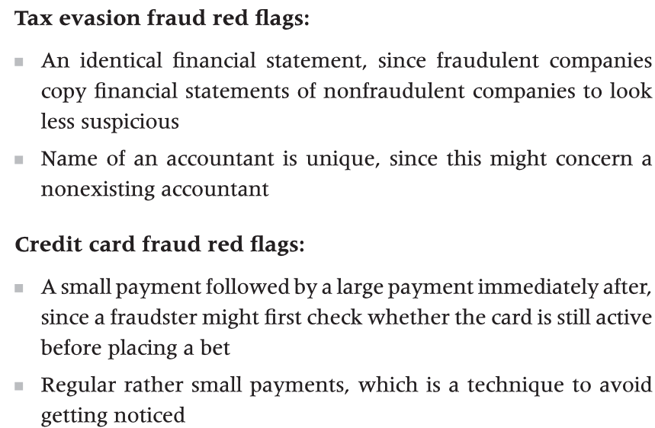
Examples of Red Flags

Slide 18
False Positive vs False Negative
 | False Positive | False Negative
Definition | Red flags identified in the fraud data profile but the transaction is NOT a fraudulent transaction. | Red flags NOT identified in the fraud data profile but the transaction is a fraudulent transaction.
Effects | Too many false alarms might render the fraud analytics results not useful. | Missing out too many actual fraudulent transactions means the fraud data analytics is useless.
Reasons | Threshold of red flags too sensitive | Not understanding well about the fraud scenarios Data integrity issues, lack of data, etc.
Strategies to resolve | To reduce the number of false positives through fraud data analytics plan; To allow user to resolve the false positives through manual procedures. | To review the fraud data analytics plan so as to have a better understanding of the fraud scenarios; To review the issues related to data, from data collection, pre-processing, to data analysis.

Slide 19
False Positives vs False Negatives – which one is more problematic?

Slide 20
An Overview of Fraud Data Analytics Methodology
Dr. Vivien CHAN

Slide 21
Overview: Fraud Data Analytics Methodology
Define scope of Fraud Data Analytics
Data Analytics Strategies for Fraud Detection
Selection of Fraud Data Analytics Model
Fraud Scenario Identification
Staring point.
BUT the process is cyclical,
NOT linear.

Slide 22
1: Define the scope of fraud analysis
A few examples:
If the fraud data analytics is used in a whistle blower allegation,
then the fraud data analytics plan is designed to refute or corroborate the allegation.
If the fraud data analytics plan is used in a control audit,
then the fraud data analytics would search for internal control compliance or internal control avoidance.
If the fraud data analytics is used for fraud testing,
then the fraud data analytics is used to search for a specific fraud scenario that is hidden in your database.

Slide 23
Overview: Fraud Data Analytics Methodology
Define scope of Fraud Data Analytics
Data Analytics Strategies for Fraud Detection
Selection of Fraud Data Analytics Model
Fraud Scenario Identification
Staring point.
BUT the process is cyclical,
NOT linear.

Slide 24
2: Fraud Scenario Identification
Inherent Fraud Schemes
The theory states that the number of inherent scheme and scenarios are finite and predictable
Comprises a committing person, an entity structure and a fraudulent action
Each inherent fraud scheme has a finite and predictable list of fraud permutations
Each fraud scheme permutation creates a finite and predictable list of fraud scenarios
How the inherent scheme occurs will be influenced by the business processes and internal controls
Fraud is predictable, with regard to the schemes that occur
Number of schemes is finite, that can occur in a given business system

Slide 25
2: Fraud Scenario Identification
Fraud scenario
Committing person
Entity
Fraudulent action
The person committing the fraud
The person can be from internal or external
The person who have direct or indirect access to the database
Attachment of transaction in the business system
E.g. in payroll system, ‘employee’ is the entity
In credit card system, ‘card number’ is the entity
Fraudulent action links committing person and entity
E.g. payment of vendor without purchase order

Slide 26



2: Fraud Scenario Identification
Fraud scenario - Create the permutation of fraud scenarios
Committing person
Fraudulent action
Entity
Fake Vendor
Overbilling
Real Complicit Vendor
Company Procurement Cardholder
Multiple procurements
Real Non-Complicit Vendor
Conflict-of-interests

Slide 27
Overview: Fraud Data Analytics Methodology
Define scope of Fraud Data Analytics
Data Analytics Strategies for Fraud Detection
Selection of Fraud Data Analytics Model
Fraud Scenario Identification
Staring point.
BUT the process is cyclical,
NOT linear.

Slide 28
3: Data Analytics Strategies for Fraud Detection
There are 2 steps
Step 1: Handling the raw data
Obtaining the raw data
Cleaning the data
Data pre-processing
…
Step 2: Strategies for data analytics
NOTE:
Techniques for handling raw data will be discussed later

Slide 29
The world’s best auditor using the world’s best audit program cannot detect fraud unless their sample includes a fraudulent transaction.

Slide 30
What are “Fraud Data”?
Which of the following are “Fraud Data”?
Bank Statements?
Network logs?
Customer data?
Firewall logs?
Email?
Whatsapp/Wechat/LINE or any other IM messages?
FB/IG/MeWe or any other social media pages?
Public information, e.g. news?
Documentation, e.g. user guides?
Server room check-in and check-out logbook?
CCTV?
…

Slide 31
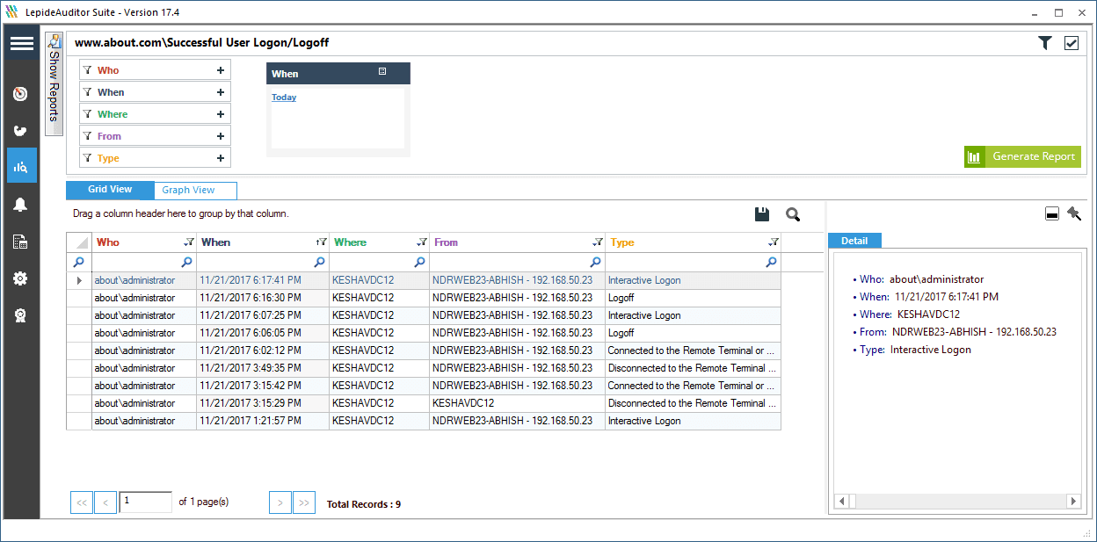
Example of raw data – user login access log

Slide 32
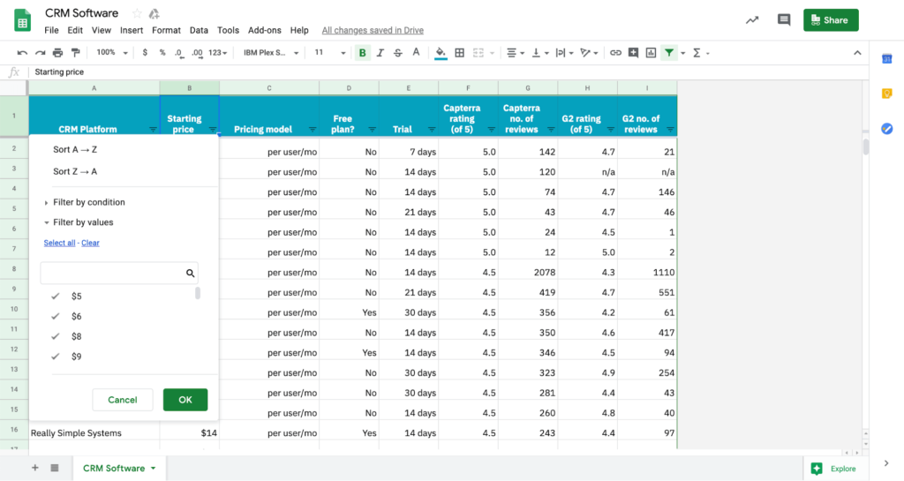
Example of raw data – CRM records

Slide 33
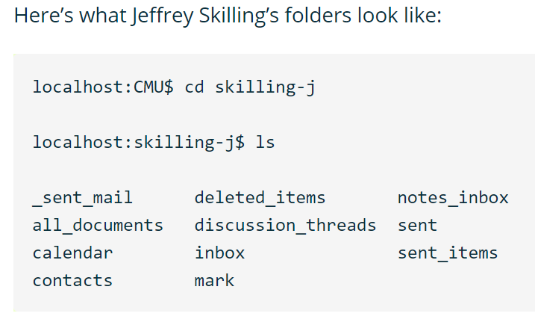
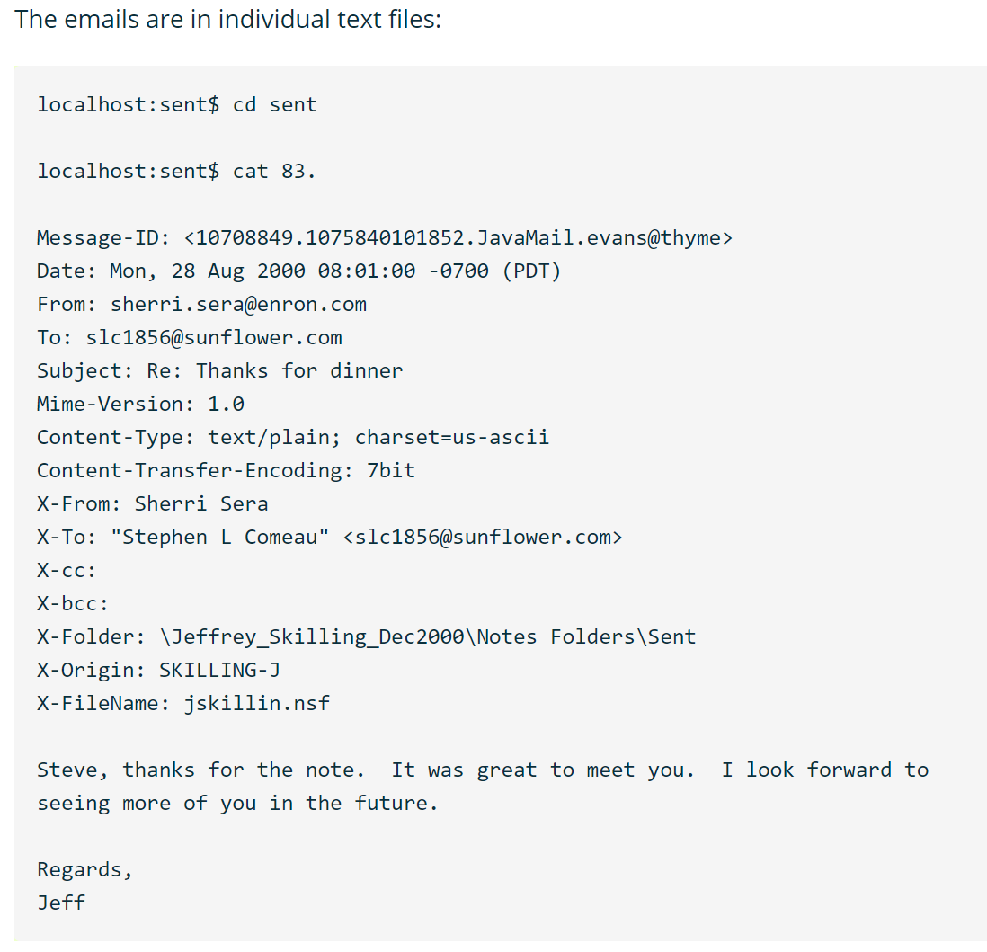
Example of raw data - email
Sample raw data files extracted from Enron case

Slide 34
Question:
What is
“Financial Fraud”?
Any examples?
What are the possible problems with the raw data collected?

Slide 35
“Data” used in Fraud Detection
What are the problems with real-life data?
Inconsistencies
Incompleteness
Duplication
Merging
Data size too big to handle
… and many more
Thus, it is critical to pre-process the raw data before proceeding to conduct the analysis steps

Slide 36
“Data” used in Fraud Detection
What are the types of data sources?
Structured
Transactional data
Contractual, subscription, or account data
Surveys
Behavioural information
Unstructured
Text documents, e.g. emails, web pages, claim forms or multimedia contents
Contextual or network information
Qualitative expert-based data
Publicly available data
Semi-structured

Slide 37
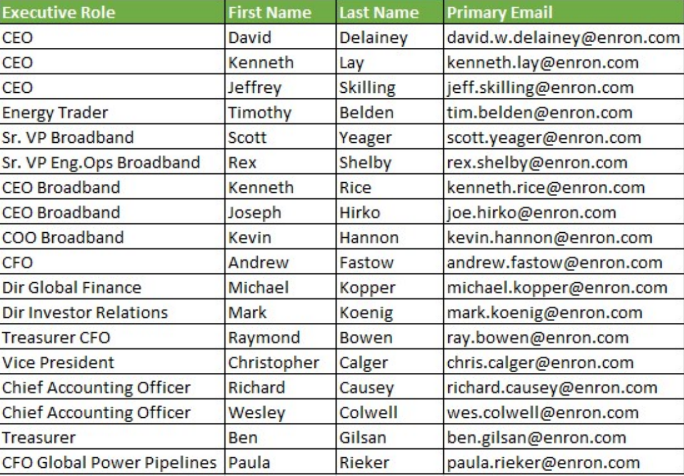
Some Basic Concepts - Data Table
Columns = variables, fields, characteristics, attributes, features, etc.
Rows = instances, observations, lines, records, tuples, etc.
Sample data records extracted from Enron case

Slide 38
Basic Concepts – Data types
Continuous data
Defined on an interval, with limited or unlimited value
With or without a natural zero value
Example:
amount of transactions
balance on savings account
similarity index

Slide 39
Basic Concepts – Data types
Nominal
Ordinal
limited set of values with no meaningful ordering in between
take on a limited set of values with a meaningful ordering in between
Binary
can only take on two values
Categorical data
e.g. marital status; payment type; country of origin
e.g. age coded as young, middle-age, and old
e.g. yes/no

Slide 40
Data Analytics Strategies
1/ Specific identification strategy
Usually this is based on the fraud scenarios to identify specific issues
2/ Internal control avoidance
To check the data against any company internal control policies
3/ Data interpretation
To identify patterns of behaviours from the data
4/ Number anomaly
There are several statistical techniques, e.g. Benford’s law (to be discussed in later lecture).
Benford’s law : search for anomaly in the first, second, etc. integers of an amount. The anomaly is based on Benford’s distribution table.

Slide 41
Overview: Fraud Data Analytics Methodology
Define scope of Fraud Data Analytics
Data Analytics Strategies for Fraud Detection
Selection of Fraud Data Analytics Model
Fraud Scenario Identification
Staring point.
BUT the process is cyclical,
NOT linear.

Slide 42
4: Selection of Fraud Data Analytics Model
Supervised Learning
Unsupervised Learning
Semi-supervised Learning
Social Network Analysis
Predictive analytics
Linear/Logistic Regression
Decision Tree
Ensemble Method
Random Forest
Neural Network
Support Vector Machines
… many more
Descriptive analytics
Clustering (k-means)
Anomaly detection (One-class SVM)
… many more
Network analytics
Social Network Analysis
Statistical analytics
Outlier detection techniques
Break-Point Analysis
Peer-group Analysis
Benford’s Law

Slide 43
ML algorithms classification
Supervised Learning
Un-supervised Learning
Semi-supervised Learning
Reinforcement Learning
Input data : labelled
Learning process : learning based on labelled input data, compares the predicted results with the actual results, and adjusts the predictive model until the predicted results of the model reach an expected accuracy.
Common algorithms : decision trees, linear regression, logistic regression, support vector machines, neural networks, and so on.
Applicable to : classification and regression problems.
Learning process: to infer the intrinsic links of data, such as clustering and association rule learning.
Input data : not labelled
Common algorithms : cluster analysis, auto-encoder.
Input data : partly labelled
Learning process: an extension of supervised learning, or combination with un-supervised learning
Applicable to : classification and regression
Input data : as feedback to the model
Learning process: emphasizing how to act based on the environment to maximize the expected benefits. The difference between supervised learning is that it does not require the correct input/output pairs and does not require precise correction of sub-optimal behaviour.
Applicable to: online planning and application that requires a balance between exploration (in the unknown) and compliance (existing knowledge).

Slide 44
Fraud Detection Classification Models
Fraud detection models can be broadly divided into:
Classification – when the output variable is a category, e.g. “fraud” or “non-fraud”
Regression – when the output variable is a real value, e.g. probability score of fraud case
In essence, we have input X, model D, output Y
Input X
X1
X2
X3
Model D
Supervised
Unsupervised
Output Y
Class labels (Y =1 or Y =0)
or Fraud scores (Y)

Slide 45
Fraud Detection Techniques
These techniques are not mutually exclusive but complement each other
An effective fraud detection and prevention system may combine the use of these different techniques

Slide 46
02 Credit Card Fraud Scheme
Dr. Vivien CHAN

Slide 47
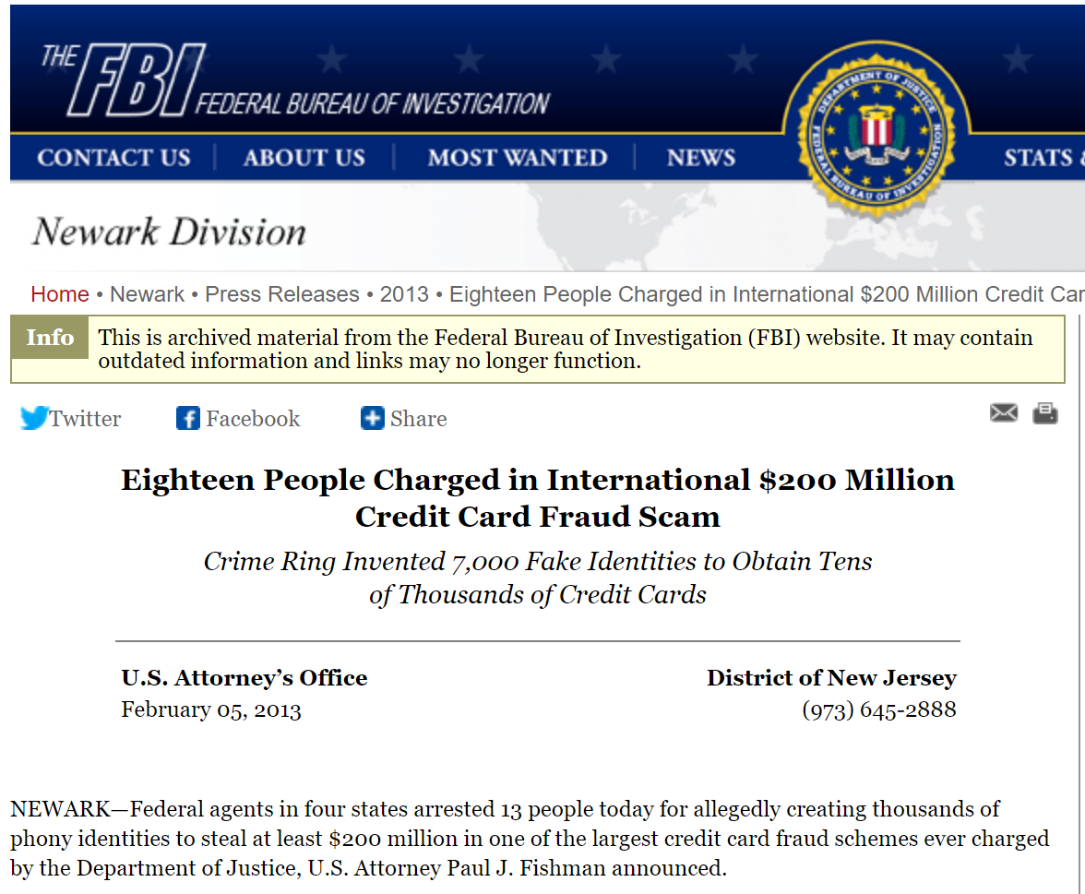
Credit Card Frauds – some example scenarios
Credit Card fraud, 2 subtypes (Bolton and Hand, 2002)
Application fraud
involving individuals obtaining new credit cards from issuing companies by using false personal information
spending as much as possible in a short space of time
Behavioral fraud
where details of legitimate cards are obtained fraudulently and sales are made on a “Cardholder Not Present” basis
does not required stealing physical card
behavioral fraud concerns most credit card fraud

Slide 48
Any other possible scenarios for credit card frauds?

Slide 49
Overview: Fraud Data Analytics Methodology
Define scope of Fraud Data Analytics
Data Analytics Strategies for Fraud Detection
Selection of Fraud Data Analytics Model
Fraud Scenario Identification
Staring point.
BUT the process is cyclical,
NOT linear.

Slide 50
Case Background
Background:
Credit card division of a large international bank in Brazil
Credit card holders who don’t want to pay the annual fees may call the bank asking for cancelation or a fee reduction
Bank representatives negotiate with the clients about the fees. During the discount negotiation process, bank representatives should follow the bank policy; they cannot offer discounts higher than their authority. And within their jurisdiction, they should also give top priority to the benefit of the bank. In other words, they should offer the lowest discounts acceptable to the clients.

Slide 51
1: Define scope of Fraud Data Analytics
What is the type of credit card fraud scenario?
Example: Credit card renewal discount offer
What are the objectives of the fraud data analytics?
To identify any non-compliance behaviours of credit card representatives that would case revenue loss of the credit card company
Source: Liu, Qi. (2019). An Application of Exploratory Data Analysis in Auditing – Credit Card Retention Case. 10.1108/978-1-78743-085-320191001.

Slide 52
2: Fraud Scenario Identification
Example#1: Credit card renewal discount offer
Who is the committing person?
Credit card representatives
What are the possible entities involved?
Cardholder (can be real of fake)
What are the possible fraudulent actions?
Offering higher discounts than allowed
Offering high discounts without making an effort to negotiate with cardholder
Offering discounts without negotiation with cardholder
Conflict-of-interests
…

Slide 53
2: Fraud Scenario Identification
Create the permutation of fraud scenarios
High discount outside company guideline
Real cardholder
High discount without negotiation
Credit card representatives
High discount without making effort for negotiation
Fake cardholder

Slide 54
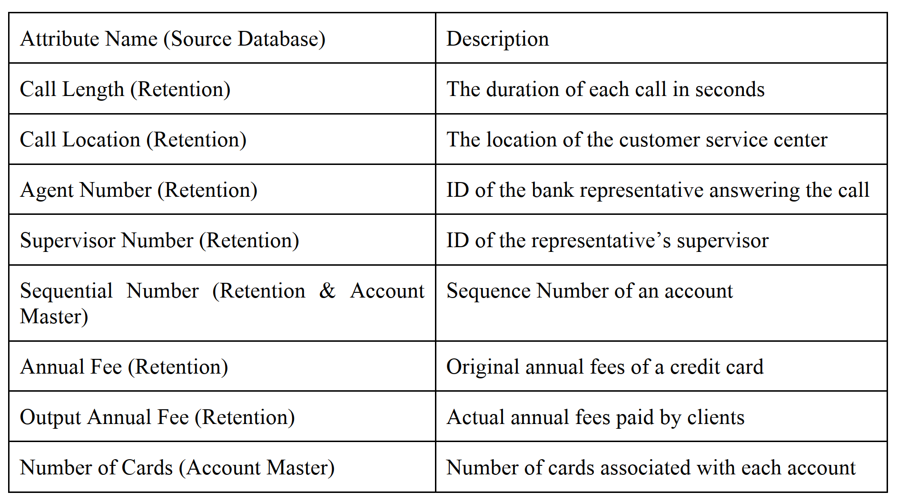
3: Data Analytics Strategies for Fraud Detection
The account master data is a large dataset with 60,309,524 records and 504 fields.
Description of 8 selected attributes in this credit card case
Source: Liu, Qi. (2019). An Application of Exploratory Data Analysis in Auditing – Credit Card Retention Case.

Slide 55
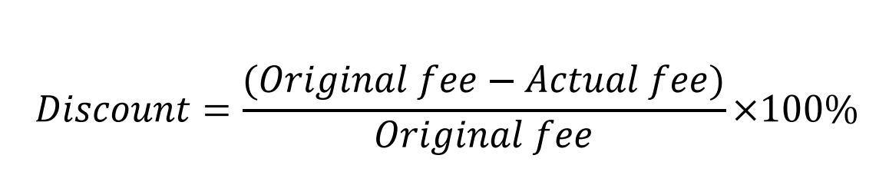
3: Data Analytics Strategies for Fraud Detection
Data pre-processing
E.g. Data transformation
achieved by the logarithm function.
E.g. Feature re-engineering: Creation of new attributes – ‘Discount’
2 attributes related to ‘Discount’
Original fee = original annual fee
Actual fee = actual annual fee paid
Q: What does the following values mean?
Case 1: Discount = 0%
Case 2: Discount = 100%
Case 3: Discount = -ve value
Source: Liu, Qi. (2019). An Application of Exploratory Data Analysis in Auditing – Credit Card Retention Case. 10.1108/978-1-78743-085-320191001.

Slide 56
3: Data Analytics Strategies for Fraud Detection
4 data analytics strategies
1/ Specific identification strategy
E.g. credit card holder with credit card numbers inconsistent with the company’s offer
2/ Internal control avoidance:
E.g. offer of discount that is not complied with company policy
3/ Data interpretation
E.g. pattern and frequency of discount offer by credit card representatives
4/ Number anomaly
E.g. any questionable discount offer

Slide 57
4: Selection of Fraud Data Analytics Model
NO single rule for model selection
1st technique : Exploratory Data Analysis (EDA)

Slide 58
Introduction to Exploratory Data Analysis (EDA)
Dr. Vivien CHAN

Slide 59
Exploratory Data Analysis (EDA)
Exploratory Data Analysis (EDA, Tukey, 1977) is the process of using quick and simple methods for the visualization and examination of small data sets, e.g. boxplots, histograms, etc.
However, with the growing size (5Vs) of data sets nowadays, it is not feasible to use only traditional EDA to analysis data sets

Slide 60
Exploratory Data Analysis (EDA)
Purpose of EDA:
to have a better understanding of the data before building the fraud detection model
to detect problems in data
When performing EDA, fraud analyst need to keep the following in mind:
What is the purpose of this fraud analysis?
What are the insights or in-depth knowledge about the fraud that can be derived?
Are the objectives of EDA aligned with the problem on hand?

Slide 61
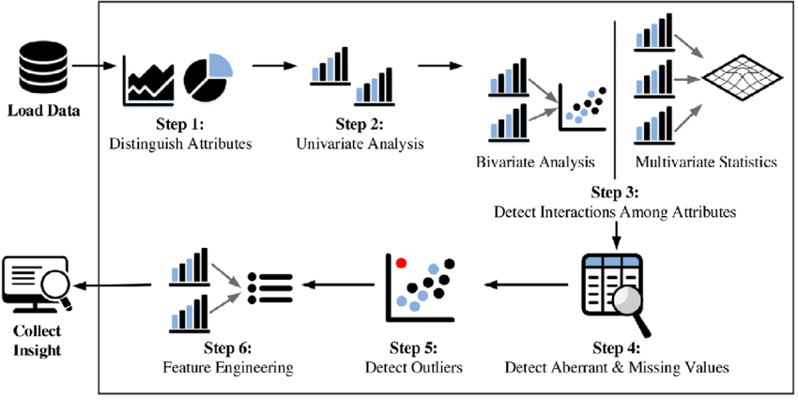
Step-by-step EDA
Ref: Ghosh et al. (2018). A comprehensive review of tools for exploratory analysis of tabular industrial datasets

Slide 62
EDA – Step 1: Distinguish Attributes
Objective
To identify the attributes in a dataset in order to formulate a clearer goal of the data analytics process
Explore what?
Attribute names, datatypes, number of attributes, etc.
Techniques
Descriptive summary of the dataset
Continuous vs Categorical data types
To understanding the meaning of each attribute before analyzing the data

Slide 63
Statistics Summarizing
Make use of descriptive statistics, including, mean, median, standard deviations, percentile distribution, etc.
Mean value and median value are basic descriptive statistics for continuous variables; while mode (i.e. most frequently occurring value) is used for categorical variables
Standard deviation can provide insight with respect to how much data is spread around the mean.
Percentile value like 10, 25, 75, 90 percentile provide information about the distribution of the data
Descriptive statistics can be used as a preview to check the symmetry or asymmetry of the distribution, i.e. skewness of the data.

Slide 64
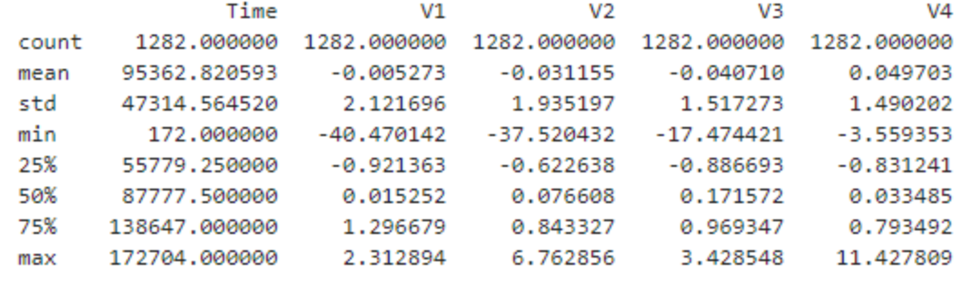
EDA – statistics examples
Basic statistics measurement
In additional to calculating the above statistics for the whole sample set, can also calculating for each target set (i.e. fraud and non-fraud cases) to observe the differences between the target sets (e.g. different average age)

Slide 65
EDA – Step 2: Univariate Analysis
Objective
Gain a better or deeper understanding of each attribute
Explore what?
Centrality: i.e. mean, median, mode
Techniques
Visualization tools, e.g. histogram, boxplot, scatter-plot
Identify combinations of attributes for subsequent analysis
Identify “noise” in the dataset, e.g. missing values, outliers
Discretize continuous variables, i.e. convert continuous variables into categorical variables
Dispersion: i.e. range, variance, standard deviation, skewness and kurtosis

Slide 66
Visualization
Descriptive statistics sometimes may be difficult to interpret, visual plots of the distributions of the involved variables will give insights about the data and problem
Missing data, outliers, and distribution can be more easily identified using visualization of the data
Visualization might include plotting of histograms, box plots, etc.

Slide 67
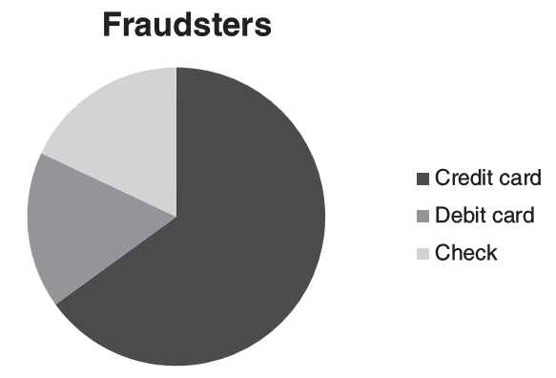
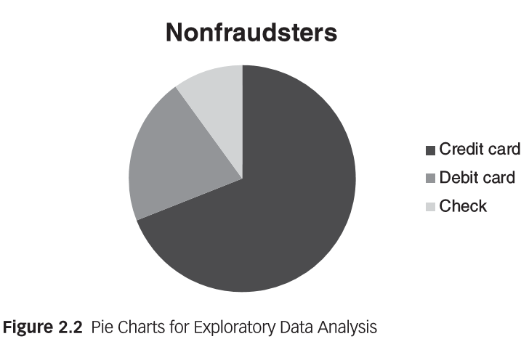
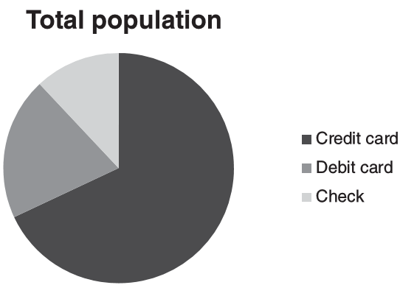
EDA – visualization example
Pie Charts – represents a variable’s distribution
Histogram – visualize the central tendency and variability of the data
Scatter plot – visualize the correlation patterns in data
…

Slide 68
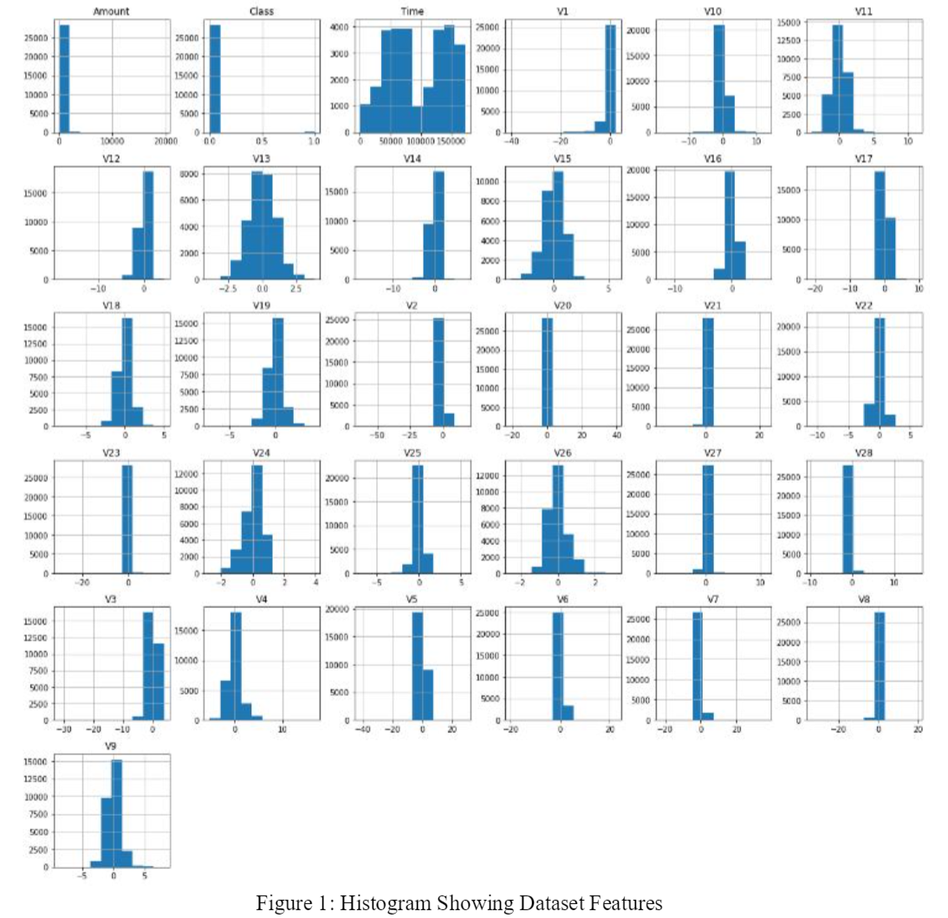
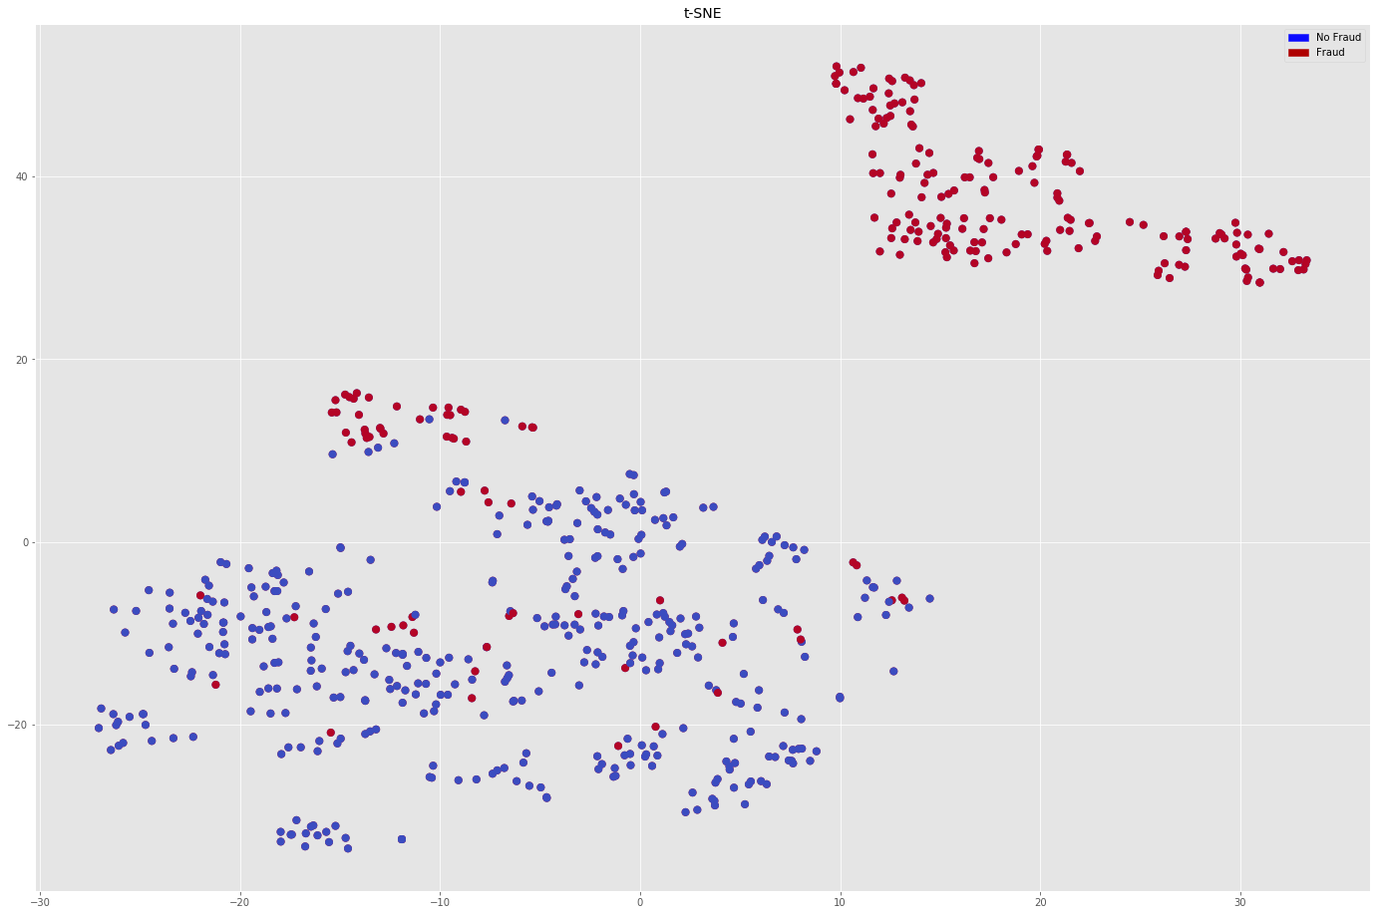
EDA – visualization example

Slide 69
EDA – Step 3: Bi-/Multi-variate Analysis
Objective
To detect interactions among attributes
Understand relations among the attributes
Explore what?
Bivariate analysis : analyses the associations between 2 attributes only
Techniques
Visualization tools, e.g. histogram, boxplot, scatter-plot, heatmap
Multivariate analysis : analyses the associations among more than 2 attributes
Identify incompatibilities among attribute values
Generate optimal feature combinations
Correlation analysis, e.g. Pearson correlation
Performs bivariate analysis BEFORE multivariate analysis. With bivariate analysis, will have a clear idea of the compatibility of an attribute pair. Then, can combine more attributes with pairs for further analysis

Slide 70
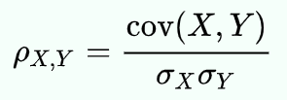
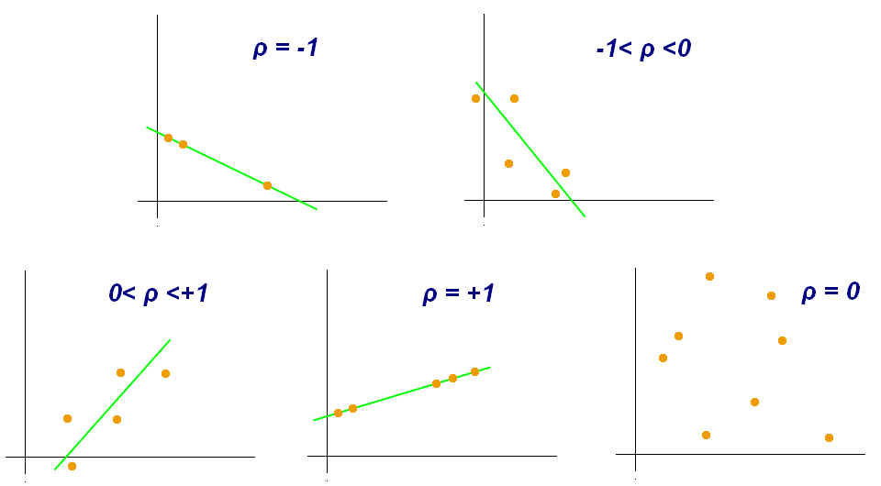
Correlation Analysis
It is a powerful technique that helps you understand the relations between different variables, i.e. whether the variables are positively or negatively correlated
Pearson correlation is most commonly used
the covariance of the two variables divided by the product of their standard deviations
If the coefficient lies between ±0.5 to ±1.0, it is highly correlated
If the coefficient is below ±0.29, the correlation is low
Source: Wikipedia

Slide 71
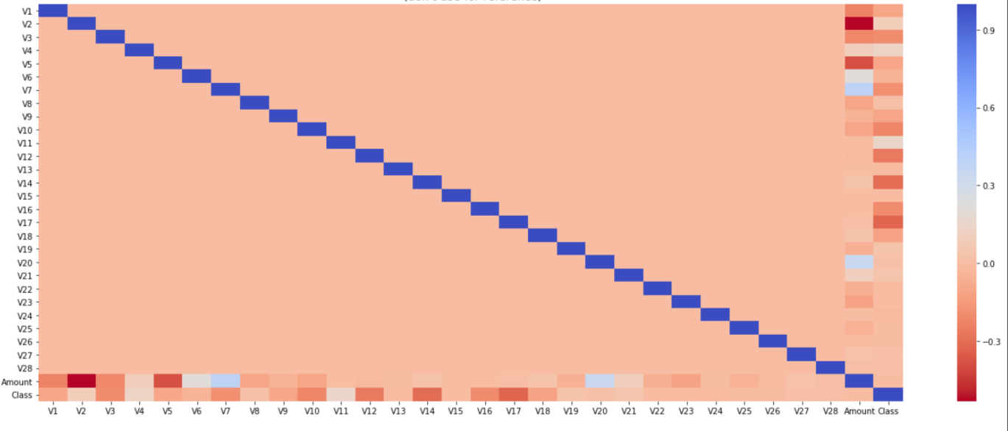

Correlation Analysis - Example
Why?
Looking at the heatmap of correlation, many of the variables are NOT significantly correlated with each other and the Class variable

Slide 72
EDA – Step 4: Detect aberrant & missing values
Objective
Aberrant and missing values may result in biased analysis of data. Thus, need to identify and detect any outliers and missing values in the dataset
Explore what?
Aberrant values : Erroneous values which occur as a result of incorrect user inputs or calculation errors
Techniques
Performs AFTER multivariate analysis when you have a clearer idea about the attributes
Missing values : Occur in a dataset during data extraction and/or data collection.
Detection of abnormalities in univariate, bivariate and multivariate visualizations

Slide 73
Data Cleaning
Raw data contains noise, inconsistencies and incompleteness.
“Dirty” data can cause confusion for the data analytics procedure.
Incomplete/Missing data
Noisy data (outliers or errors)
Data inconsistencies (similar to data conflict in data integration)
Duplicate records (similar to data duplication in data integration)
Thus, data cleaning is an essential process in data pre-processing.

Slide 74
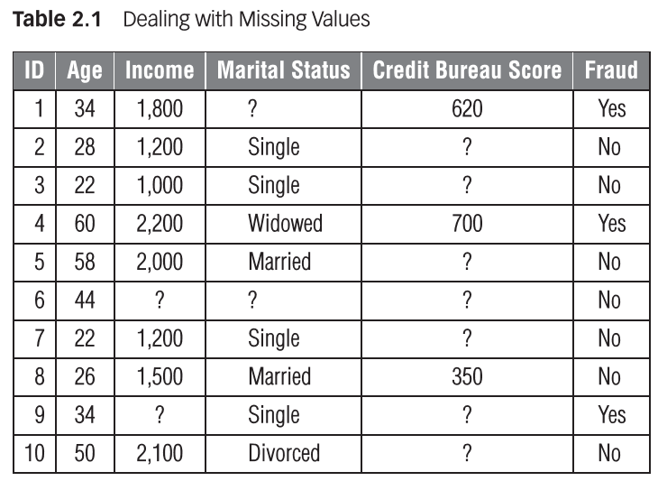
Aberrant and Missing Data
Reasons of aberrant and missing data
Human input error
Intentionally hiding some information
Not applicable values, e.g. if there are records without visa card, visa card transactions will be not applicable
Not matching search or filter criteria, e.g. if transaction > 1 billion

Slide 75
How to handle missing data?
Techniques
Supervised Learning
Un-supervised Learning
Semi-supervised Learning
Reinforcement Learning

Slide 76
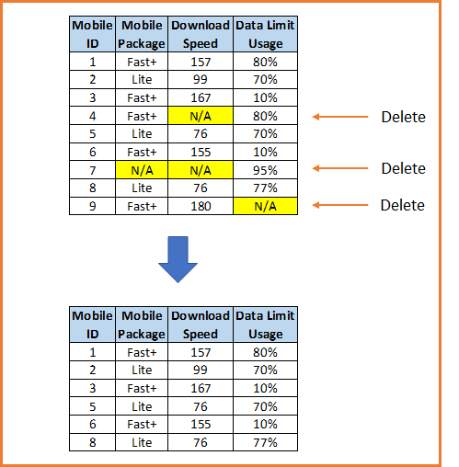
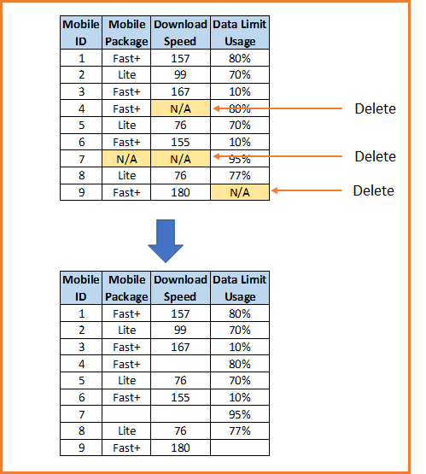
Handling Missing Data - deletion
Likewise/Listwise Deletion
Pairwise Deletion

Slide 77
Handling Missing Data - deletion
Likewise/Listwise Deletion
Simplest way to handle missing data
A record is completely removed if it is missing the value of one of its variables
Pairwise Deletion
Omits the variables with missing value and all records are involved in the analysis
Keeps all the records in the dataset
Problem with this is reduced sample size and possibility of missing some important information
Still have the problem of drawing conclusions based on a subset of data only

Slide 78
Handling Missing Data-Imputation
Data Imputation : Fill in the missing data
4 techniques
MICE – a package in R
Simple imputation | Synthetic distribution | Model-based estimation | Multiple imputation
Fill in the missing data by mean/median/mode | Fill in the missing data based on a synthetic distribution curve | Use a predictive or statistic model to impute the missing data, e.g. regression, random forest, knn | Use the distribution of the observed data to estimate a set of plausible values for the missing data. Random components are incorporated into these estimated values to show their uncertainty.
Can keep the sample mean value | Easy to understand and communicate | Keeps all the records and avoids altering the mean or distribution | Keeps the variability and uncertainty of missing data, resulting in more valid statistical inference
May lead to bias if the sample is not completely random | Assumes outcome remains unchanged by missing data, but in real-world this usually is not the case | Missing value is created by prediction based on values from other variables, that means no actual novel information is included | Need to build separate models for data imputation, in addition to the analysis model

Slide 79
EDA – Step 5: Detect outliers
Objective
Outliers might result in biased analysis of data
Explore what?
Outliers in a dataset can be primarily of three types namely: univariate,
bivariate, and multivariate outliers
Techniques
Univariate outliers : can be detected by calculation of the Inter-Quartile
Range (IQR)
Bivariate and multivariate outliers : need to inspect correlations among different attributes

Slide 80
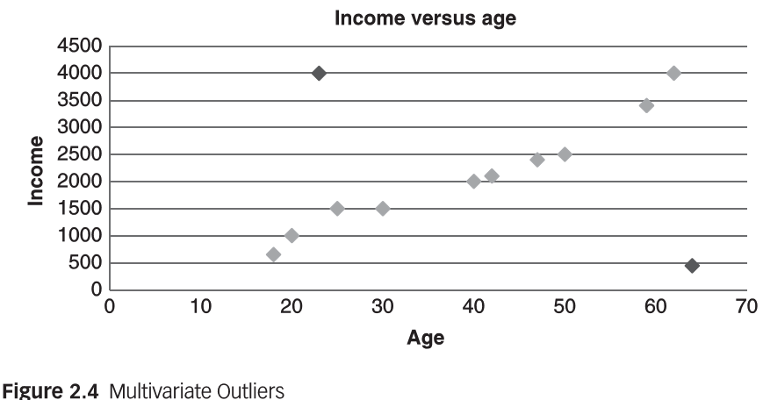
Outliers
Outliers – extreme observations that are dissimilar to the rest of the population
Reasons of outliers
Valid observations: e.g. salary of senior management > US$1M
Invalid observations: e.g. age > 300

Slide 81
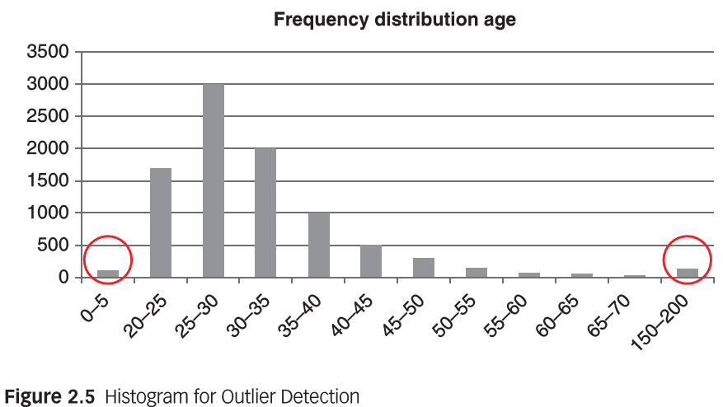
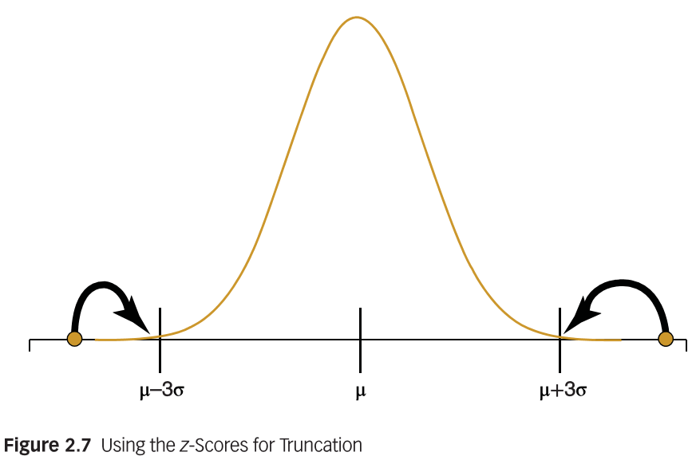
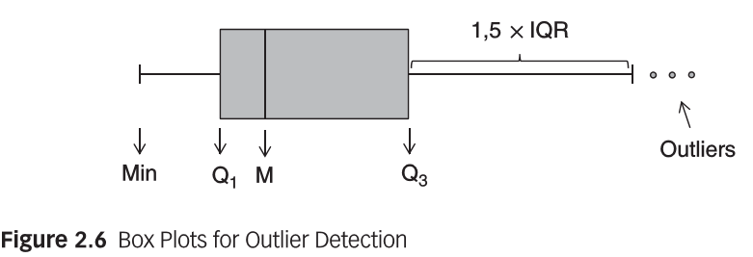
Detection of outliers
Calculate minimum, maximum, z-score values for each attribute. Define outliers when absolute value of z-score is larger than 3.
Use visualization, e.g. histogram, box plots

Slide 82
Outliers or Red Flags
In cases of fraud analysis, outliers may sometimes be actually the fraud cases that concern us
Behaviours of fraudsters usually deviant from normal non-fraudsters.
These deviations from normal patterns are Red Flags of fraud, e.g.
Identical financial statements may be Red Flag for tax evasion
Small payment followed by a large payment immediately after may be Red Flag for credit card fraud
Caution should be taken when treating outliers, or marked these observations as outliers for further analysis

Slide 83
Handling outliers
Treatment
For invalid observations, treat the outlier as missing value and can use one of the techniques for handling missing value to deal with outlier value
For valid observations, truncation/capping/winsorizing, i.e. set upper and lower limits on a variable.
Z-socre (stand deviation), e.g. upper/lower limit = M ± 3 x z-score
IQR (interquartile range), e.g. upper/lower limit = M ± 3 x IQR/(2 x 0.6745) (Van Gestel and Baesens, 2009)

Slide 84


Slide 85
Step-by-step EDA
Ref: Ghosh et al. (2018). A comprehensive review of tools for exploratory analysis of tabular industrial datasets

Slide 86
Univariant Analysis
Descriptive statistics used in this study include frequency distribution, summary statistics (mean and standard deviation), and categorical summarization.
Looking at the following one by one:
‘Discount’ offer patterns and frequencies
‘Discount’ by agent number (i.e. credit card representatives)
‘Discount’ by call lengths
‘Discount’ by call locations
….

Slide 87
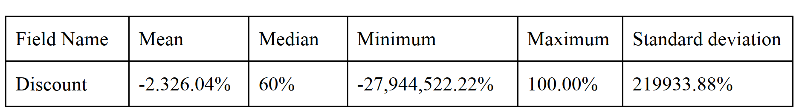
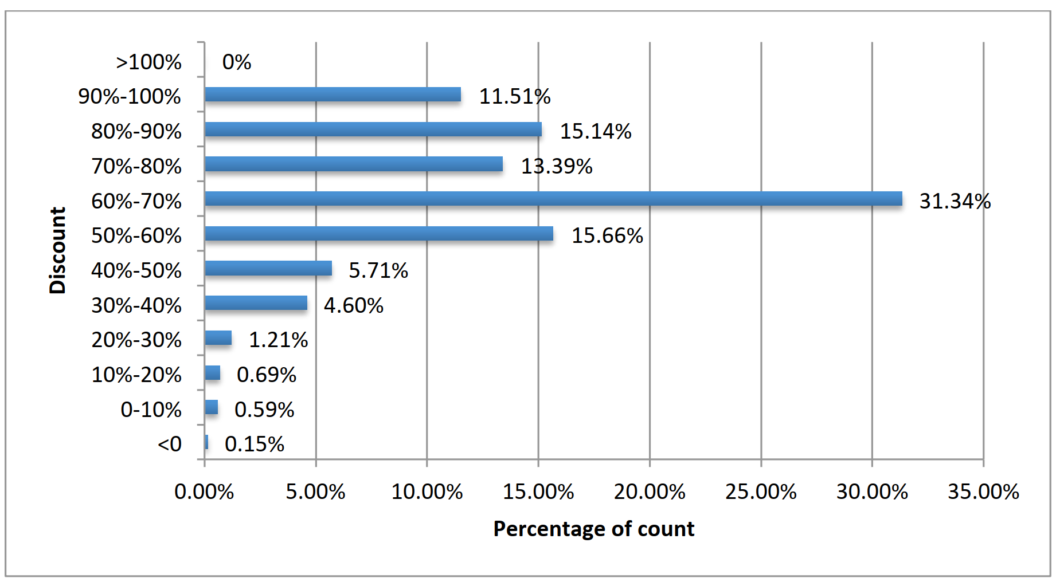
Univariate Analysis : ‘Discount’
Any insights you get from this initial univariate analysis?

Slide 88
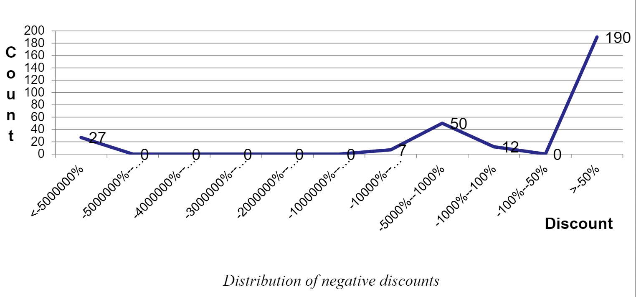
Univariate Analysis : ‘Discount’
Why is –ve discount recorded?

Slide 89
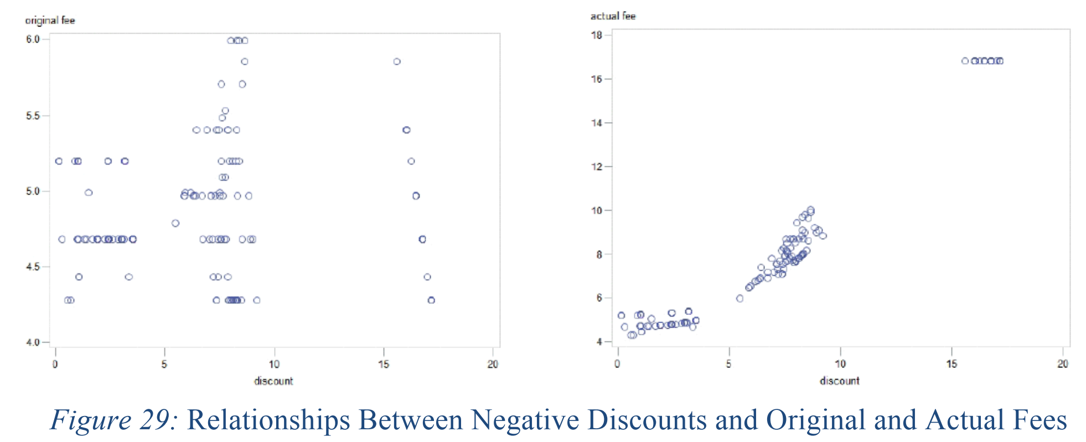
Multivariate Analysis : Discount vs Fee
Data transformation:
Original Fee & Actual Fee => logarithmic value
-ve discount => absolute logarithmic value
EDA => Scatter plot

Slide 90
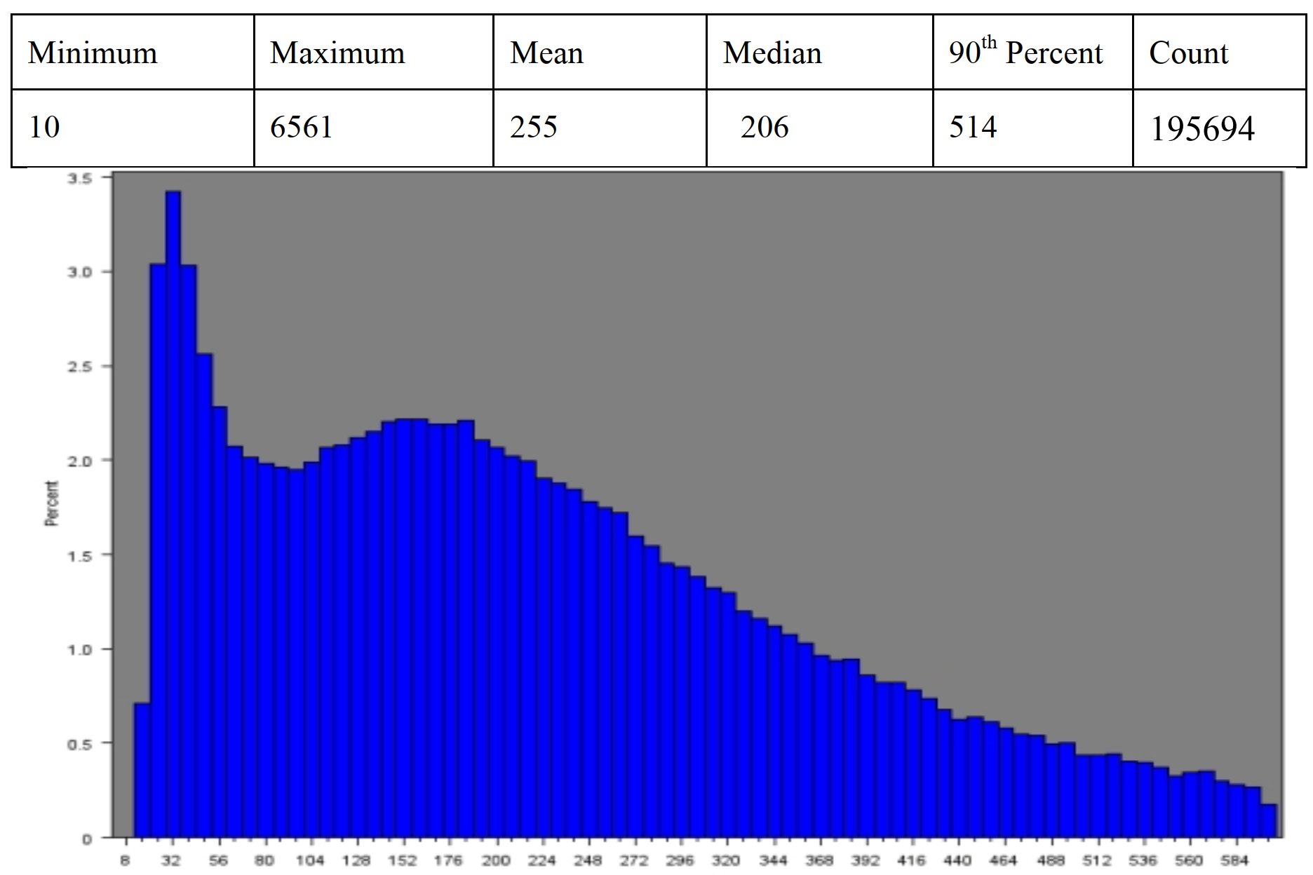
Univariate Analysis : ‘Call duration’
Any insights you get from this initial univariate analysis?
Call duration in seconds

Slide 91
References
Bart Baesens, Veronique Van Vlasselaer, Wouter Verbeke (2015). Fraud Analytics using Descriptive, Predictive, and Social Network Techniques, 1st ed, John Wiley & Sons Inc.
Leonard W. Vona (2017). Fraud Data Analytics Methodology: The Fraud Scenario Approach to Uncovering Fraud in Core Business Systems, John Wiley & Sons, Inc.
Aindrila Ghosh, Mona Nashaat, James Miller, Shaikh Quader, Chad Marston (2018). A comprehensive review of tools for exploratory analysis of tabular industrial datasets. Visual Informatics 2 (2018) 235–253.
Lunardon, N., Menardi, G., & Torelli, N. (2014). ROSE: a Package for Binary Imbalanced Learning. R J., 6, 79.
G. Menardi and N. Torelli. (2014). Training and assessing classification rules with imbalanced data. Data Mining and Knowledge Discovery, 28(1):92–122.
StatQuest: Principal Component Analysis (PCA), Step-by-Step (2018). https://www.youtube.com/watch?app=desktop&v=FgakZw6K1QQ

Slide 92
QUESTIONS?

